Slide 1
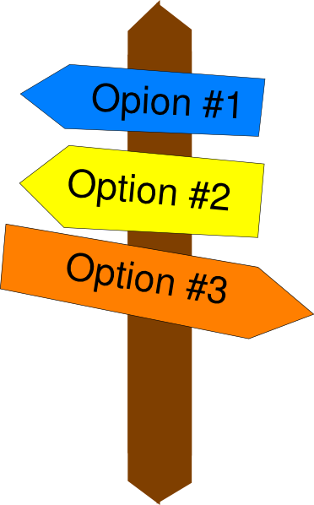
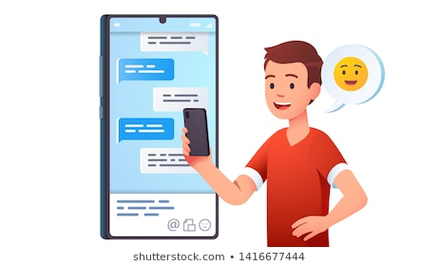
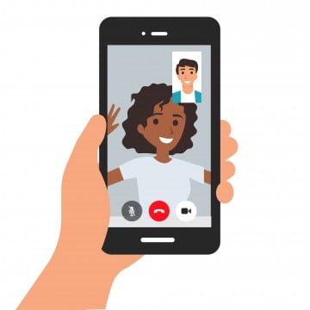
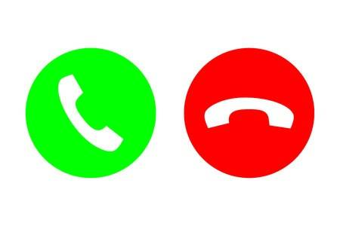
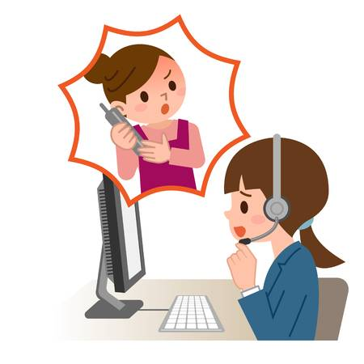
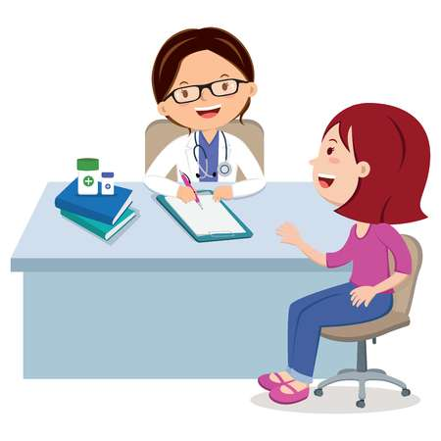
Greater Glasgow Dermatology New Virtual Clinic Options
Would you prefer a Virtual Appointment and consultation rather than coming to Hospital ?
Less travel
No waiting rooms
More convenient
We now have a number of options that may be suitable for you to discuss with your clinician
Option 1
Option 2
Option 3
Option 4
Online App Consultation
Email / photos
Live Video Consultation
Attend Anywhere
Telephone Consultation
Traditional Hospital Visit Face to Face
If you previously attended regularly, future appointments could vary between these options. Your clinician will now be offering these where appropriate or alternatively please ask....
72
YEARS
#nhsscot72

