Slide 1
Essential Skills for Managers
Day 1
You and your team

Slide 2






Domestic arrangements

Slide 3
Programme aims
Introduce, and help you apply, common but often taken-for-granted management skills.
Day 1 will cover key principles of communication (team and individual) and how to be more effective in organising and delegating.
Day 2 focuses on your role in supporting and managing change and supporting improvement in the workplace including problem solving and decision making.
This programme may link to your KSF Outline in the following dimensions,
C1 – Communication, C2 – Personal & People Development, C3 - Health, Safety & Security, C5 – Quality, C6 - Equality & Diversity, G6 – People Management

Slide 4
Your objectives
Throughout the programme you will be prompted to reflect on the objectives you identified in the pre-programme questionnaire and to think about ways in which you can apply learning in your workplace.
These include,
key personal learning points
any immediate impact of the programme (personally and/or on the service)
action planning (proposed impact)
The accompanying workbook will also support your reflections and provide further resources.

Slide 5
Evaluation
Pre-programme questionnaire.
Post-programme survey asking for feedback on content, delivery and you initial plans.
We will contact you and your manager approximately 12 weeks after the programme to gather feedback on how your learning has been applied.

Slide 6
Essential Skills for Managers
Session 1
Communicating and Influencing

Slide 7
Communicating and Influencing
By the end of this session you will,
Understand the nature and importance of the communication process in the workplace
Understand the advantages and disadvantages of commonly used methods of communication
Be able to assess own effectiveness in communicating with and influencing others
Be ready to use tools and techniques to support more effective communication
Know about NHSGGC organisational goals and values

Slide 8
The Communication Cycle
BARRIERS
INTERFERENCE
BARRIERS
INTERFERENCE
BARRIERS
CONTEXT / PURPOSE
Sender
Message
Receiver
Transmission
Feedback

Slide 9
Barriers to effective communication
Workplace
Physical environment
Methods of communication (including feedback opportunities)
Language (relating to jargon and terminology)
Psychological and behavioural (culture of the organisation)
Inequalities
Language (English not first language or need for interpreters, use of BSL etc.)
Physiological, Mental Health / Learning Difficulties
Cultural / religious needs
Sensory impairments
Literacy, numeracy issues (affecting 1:4 adults in Scotland)

Slide 10
Self-awareness
In the workplace be committed to removing barriers by:
being familiar with Clinical Governance and HR policies and Staff Governance guidance (HR Connect)
making sure you are up-to date with equality issues and legislation (Staffnet)
For you ‘personally’
Be aware of influences on your communication e.g. personal values, first impressions, stereotyping people based on physical appearance / accent.
Be a good role model and demonstrate a commitment to equality. What you say and do and how you behave will influence others.
Ensure effective communication by understanding and using the Accessible Information Policy.

Slide 11
Active listening
Show that you're listening
  respect, eye contact, nods, “tell me more” noises
Suspend judgment
  becomes a barrier to listening, don’t assume, potentially limits understanding
  don’t interrupt
Feedback
  check understanding, summarise and rephrase
  show understanding of speaker’s underlying values and emotions
Respond
  be open and honest
  respectfully assert your views

Slide 12
Questioning
Questions we
ought to use
Open
Closed
Probing
Reflective
Comparative
Questions we
ought to avoid
Leading
Multiple
Ambiguous
Trick
Hypothetical

Slide 13
Non-verbal communication
eye contact
tone of voice
facial expressions
body language / posture
gestures
spatial distance
touch
deliberate silence

Slide 14
Communication methods
Face-to-face (individual, groups)
Written (letters, memos)
Email
Telephone, walkie-talkie
Pager
Noticeboards
Social media
eHealth platforms (e.g. emis, eESS, Turas)

Slide 15
Underpinning principles of good communication
Support equality and diversity
Support the rights of people to communicate in their preferred way, media and language
Are ethical and adhere to codes of practice relevant to your work
Respect other people’s ideas, values and principles
Ensure people’s dignity and rights when overcoming barriers to communication
15

Slide 16
How good communicators influence others
Know what you want to say and why you want to say it
Recognise potential barriers
Understand other people’s perspectives
Establish and maintain relationships
Ask questions - clarify messages
Be an active listener

Slide 17
Self-assessment
Feedback from peers.
Reflective practice, (possibly a journal to help you reflect ‘in and on’ action).
What worked / didn’t work (what did you learn from both)?
Am I doing what the policies / guidelines say?
Am I up-to-date with current developments?
Find out what's available (Staffnet, L&E Calendar or additional training opportunities, link with L&E advisors, look at LearnPro modules etc).
Workbook activity and on-line resource

Slide 18
Engaging and communicating with staff
1-2-1
Team meetings
Huddles
Team / Core Brief
iMatter
Small Change Matters

Slide 19
Stakeholder Influence Process
What do you want to achieve and why?
What will success look like and timescale?
Who needs to be influenced and in what way?
Create a plan.
Monitor and review – keep communicating.

Slide 20
Assertive Statements
Think of someone you need to challenge? What would you say?
State, specifically, what the behaviour or situation is.
State why it is a problem.
State, specifically, what change you require and the timescale for it to happen.
Listen to response
If required, repeat (3)

Slide 21
Organisational goals and values
Our values and behaviours
We put patients first
We focus on outcomes
We take responsibility
We work as one team
We always try to do better
We treat each other with respect

Slide 22

Staff Health and Wellbeing
We have a duty to be proactive and try to prevent ill health and we also need to be reactive and manage issues efficiently by being supportive of our staff.
A Healthier Place to Work – extensive information and resources to support your health and wellbeing
Your Health (StaffNet)
Stress in the Workplace – resources and policy info

Slide 23
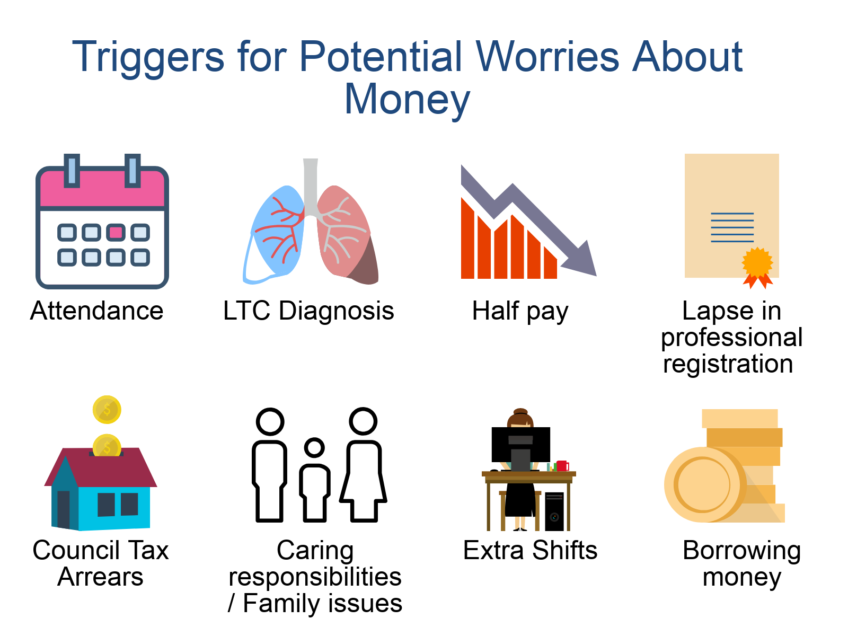

www.nhsggc.org.uk/sis
sis@ggc.scot.nhs.uk

Slide 24

Activities
(Workbook)
Notes:
Refer to workbook

Slide 25
Essential Skills for Managers
Session 2
Organising and Delegating

Slide 26
Organising and delegating
By the end of this session you will,
Recognise importance of shared objectives, team purpose and staff development
Understand key principles of delegation
Be ready to monitor and review delegated activity

Slide 27
Leadership and management – what is the difference?
Management
concerned with planning, budgeting, organising, staffing, controlling and problem-solving
Leadership
involves establishing direction, aligning people, motivating and inspiring
(Kotter 1996).
Leadership is the art of motivating people toward a common goal or vision, and management is getting the job done.
The King’s Fund report (2011)

Slide 28
What kind of manager are you?

Slide 29
Effective teams
Meaningful, clearly defined task / goal
Clear set of objectives
Team members should have unique and meaningful tasks / roles
Performance of individual team members needs assessment and feedback
Leader should give regular feedback on how well the team is meeting its objectives
Reflect on how well they are achieving the objectives that they have been set or they have set for themselves
Full participation by team members
Communication Firth-Cozens, Jenny, (1998)

Slide 30
Managing former peers
‘The team still saw me as part of their group and so did I.’
Set your expectations early on and involve the team
1-2-1 meetings
A team planning session
Use the knowledge you have to your advantage
Will help inform organising and delegating decisions
Swift intervention with resistant individuals
Move on
Achieve your objectives and ensuring everyone else in the team achieves their objectives (overall team purpose)

Slide 31
Identifying a performance issue
The key questions to determine whether there is a capability issue are:
What are the indications that the employee is not meeting the requirements of the job?
Are there factual grounds to indicate inadequate performance, such as not meeting objectives or failure to deliver the requirements of the job?
Some of the common indicators may include:-
Complaints about, or criticism of, the employee’s work from colleagues, patients or visitors.
There may be factual grounds to indicate unsatisfactory performances such as poor results.
The manager’s own observations of the employee’s performance may give rise to concerns.
The employee requesting help to overcome a problem.

Slide 32
Factors affecting performance
Lack of awareness/understanding of the standards or performance required.
Ill health
Difficulties in personal circumstances
Organisational Change
Bullying or harassment
Inappropriate or ineffective recruitment and selection processes
A combination of more than one of the above factors.
Capability Policy and Guidance

Slide 33

Team knowledge and skills
How do you know?
KSF PDP
121 meetings
Team meetings
BALM method
Skills Matrix
Training Needs Analysis
Competency checklists

Slide 34
Training Needs Analysis (Attendance Management)
Topic | I’d like refresher training | I feel competent in this area – no further training needed | I’m confident in this area and can help others learn
Recognise our duty of care and Staff Governance standards
Understand the absence reporting and recording requirements
Dealing with short-term and long-term absences
Understand how to use attendance data and its use to identify trigger points
Recognise formal and informal approaches and interventions
Return to Work interviews
Making appropriate Occupational Health referrals

Slide 35
Skills matrix
Task | Resolve customer service problems
Skill Team member | Detailed knowledge of products | Questioning and listening skills | Problem solving skills
Name 1
Name 2
Name 3

Slide 36
Skills matrix - scoring
Scoring
Score | Skill Level | Description
5 | Coach | Fully competent and experienced Needs no assistance to complete tasks Demonstrates ability to lead and train others Seen as a Subject Matter Expert
4 | Skilled | Capable and experienced Demonstrates proficiency Able to work independently with little help Will be able to Coach with more time
3 | Not yet skilled | Able to perform at a basic level Has some direct experience Needs help from time to time
2 | Learning | Limited in ability or knowledge Cannot perform for critical tasks Needs significant help from others
1 | None / Low | Unable to perform Little to no experience

Slide 37
Developing your team
KSF/PDP and Review (essential)
Show & Tell – practical
Coaching, mentoring
Sharing experience & knowledge to develop learning
Shadowing
Training courses
E-learning (LearnPro)
Delegation can also support development as well as help you run the service
9

Slide 38
Time management
Deadlines
Ask for help
Ask for an extension of the deadline
Delegate some work to others to let you meet the deadline
Open door policy
Have you got a minute? (usually means that whatever it is will take more than a minute to talk about)
I know you are busy but ... (usually means that I’m going to make you even more busy)
Can I ask about... (usually meaning whether you have the time to listen or not, I’m going to ask anyway)
I know you’re due to finish in 5 minutes but ... (usually a mix of all the brackets above meaning you won’t finish on time)
Multi-tasking - being able to ‘multi-task’ is great or is it ?
When you ‘can’ single task ‘do it’
Turn off outlook (and alerts)
Divert the phone
Do not disturb sign on the door (and tell your colleagues why)
Only have the thing you are working on in front of you

Slide 39
Timescales and deadlines
What must I do...
What should I do...
What could I do ...
Think about these in relation to a timescale to
help you plan things better
By the end of the year I must, should, could
By the end of the month I must, should, could
By the end of the week I must, should, could
By the end of the day I must, should, could
We tend to focus on the bottom 2 sometimes having to include an extra bullet
before lunch time...

Slide 40

Delegation is ….
When team members have responsibility and
authority to act within the confines of their role; or
as agreed between the manager and team member
on a task not routinely performed by a team member in that role.
Ultimate accountability remains with the manager.
Notes:
40
Throughout this session we will discuss delegation, what it means and how managers can decide what level of delegation is appropriate to use.
Emphasise how this differs from Work Allocation i.e. on tasks routinely performed by a team member in that role.

Slide 41

Delegation
What are the advantages of delegation?
What are the barriers to delegation?
15

Slide 42
Advantages of delegation
Relieves you of routine and less critical tasks
Allows you to plan for the future rather than organise for the present
Encourages decision-making
Increases motivation
Develops the capacity of staff
16

Slide 43
Barriers to delegation
‘If you want a job done properly,
do it yourself.’
It’s my job
What to delegate?
Time to explain
Will it be done right?
They might do it better than me
Information is power
Personalities
It’s too risky
But I enjoy doing it myself
I like to be on top of everything. If I delegate work I’ll lose some of this contact
They might not like me for giving them work.

Slide 44
What should be delegated?
High importance
These jobs are likely to be too important and urgent for delegating
Plenty of scope for delegating here
High
urgency
Low urgency
Too little time to delegate?
Perhaps experienced team members could do these jobs
Do these jobs need to be done at all?
Low importance

Slide 45
When delegating consider...
Reasons - why?
Results - what and how?
Deadlines - when?
Resources - with whom, what and where?
Feedback - how?
Controls
Support
21

Slide 46
Importance of reviewing
Establish the process
Review then follow up
Review progress against set objectives (SMART)
Review a little and often
Let team members come to you
Avoid blame culture
Set up one to one meetings
Keep it simple and flexible
Notes:
Why is reviewing important?
Not interfering/surveillance
support in meeting objectives and addressing issues as they arise
promotes learning for you and your team
Process;
Establish WHY and HOW – be clear on expectations, processes and communication
Balance control and avoid conveying the impression that you think they are not handling the task with the perception that they are left high and dry and under supported.
Review = Evaluate progress + take action
Corrective action may not always be needed
Celebration of job well done and recognition of strengths is as important as
identifying how else it might have been done
Use the objectives you agreed at the start of delegation to set review targets
TIME - on time? QUALITY – met necessary quality targets? RESOURCES - job well done with only resources agreed
Review a little and often – to improve the team member’s feeling of support and give you a chance to take any remedial action needed before the deadline becomes compromised
Let staff come to you – this can avoid feeling ‘checked up on’
‘No blame’ – constructive feedback
1:1 vs team meetings – when you give feedback reflects your knowledge of the individuals
Keep it simple - Not lengthy meetings or complex paperwork rather informal meeting or regular emails
Signpost to assignment ‘monitoring the outcomes of delegation in the work place’

Slide 47
SMART objectives
Specific
Clear statement of “what” needs to be achieved.
Measurable
Set clear measures in terms of cost, accuracy or other targets.
Achievable / Agreed
To be achievable, the objective must be stretching, not impossible, and motivating.
Set the objective in the context of other work, resources and general circumstances.
Seek the individual’s contribution to get their commitment.
Relevant
Ensure the individual understands why the objective is relevant to the business - it must support the overall business strategy.
Relevant to the individual - it fits with their current role and/or helps them develop skills.
Clarify what is in and out of scope of the objective.
Timed
Set clear timescales and define short / long-term objectives.

Slide 48
Giving & receiving feedback
Knowing what is expected
Supporting personal and role development
Improved working relationships through communication
Opportunity to act on good ideas as they arise
Appreciation of delegation roles
25

Slide 49
Effective feedback
balanced
- owned
- objective
- specific
- timely
BOOST
28

Slide 50
Delegation summary
Take time to prepare - think ahead
Find the right person
Consult first
Give time to support
Delegate whole tasks where possible
Specify expected outcomes
Delegate the good and the bad
Delegate - then trust
29
Notes:
50

Slide 51
Activities
(Workbook)
Notes:
Refer to workbook

Slide 52
Essential Skills for Managers
Day 2
You and the service you manage

Slide 53
Essential Skills for Managers
Session 3
Managing Change

Slide 54
Managing change
By the end of this session you will,
Understand the forces for change in an organisation and common barriers
Recognise and know how to apply key principles of change management
Recognise and be ready to use a range of tools to support the management of change

Slide 55
Reasons for change (PESTLE)
Political factors
Economic influences
Sociological trends
Technological innovations
Legislative requirements
Ecological requirements
Notes:
ASK – what reasons for change are you aware of.
Generally reflect one or more of PESTLE.
Important to know and be able to explain the reason (don’t have to agree with it!)
So how do we manage change?

Slide 56
Common barriers to implementing change
We’re not really clear why we’re doing this
We don’t really have sponsorship
More change! There’s too much going on
Our culture isn’t ready for this
Current
State
Desired
State
People seem to be resisting for no reason
Not sure about my change management role in this
The right people aren’t enagaged
We’re not organised enough
Our communications aren’t working

Slide 57
Key principles of change management
Define the change
  vision, impact, benefits, risk, communication
Understand the culture and climate
Clarify the roles in managing change
    sponsors, stakeholders, change agents, champions
Get sponsorship
  Authorising Sponsor Rule of Thumb – The person at the lowest point in the organisation to which all impacted employees report.

Slide 58

2. Understand the culture and climate

Slide 59
Key principles of change management
Get organised
  Steering group, project team, workstreams, milestones
Get human
Measure, report and review
  deliverables, outcomes, communication strategy

Slide 60
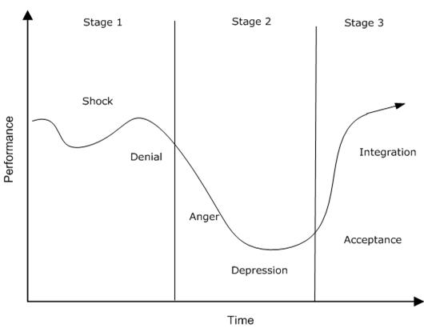
6. Get human - the change curve
Past focus
Future focus
based on Elisabeth Kubler-Ross
Notes:
60

Slide 61
Tools and techniques
Lewin’s model for change
SWOT
Lewin’s force-field model
Stakeholder analysis / engagement
Mindmaps
Gantt chart
PDSA model

Slide 62
Lewin’s model for change
UNFREEZING
CHANGING
REFREEZING

Slide 63
SWOT
S
W
Internal
Strengths
Weaknesses
O
T
Internal and/or external
Opportunities
Threats

Slide 64
Lewin’s force-field model
Competition
Skills deficit
R
E
S
I
S
T
I
N
G
F
O
R
C
E
S
D
R
I
V
I
N
G
F
O
R
C
E
S
New technology
Job insecurity
Incentives
Complacency
Managerial support (pressure)
New people
Established work patterns
Current State
Desired State

Slide 65
Stakeholder analysis
Satisfy
Manage
Opinion formers.
Keep them satisfied
with what is happening
and review your analysis
of their position regularly.
Key stakeholders who
should be fully engaged
through full communication
and consultation.
High Power
Monitor
Inform
This group requires the least effort if time and
resources are stretched.
Patients often fall into this category. It may be helpful to take steps to increase their influence by organising them into groups or active consultative work.
Low Power
Low interest
High interest

Slide 66
Stakeholder engagement
Full
Maximise
3
Their commitment to this project
1
Low
or
-ve
2
Weak
Strong
Your relationship / influence with them

Slide 67
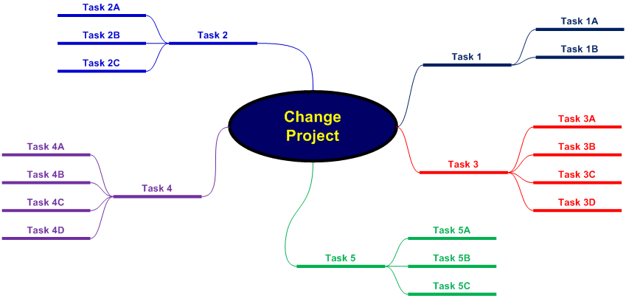
Mind maps

Slide 68
Gantt Chart
Key Activity | Lead | Week Number
 |  | 1 | 2 | 3 | 4 | 5 | 6 | 7 | 8 | 9 | 10 | 11 | 12 | 13 | 14 | 15
01. Activity A | WS
02. Activity B | KH
03. Activity C | BO
04. Activity D | PL
05. Activity E | YW
06. Activity F | YW
07. Activity G | KH
08. Activity H | LS
09. Activity I | CM
10. Activity J | KH

Slide 69
Activities
(Workbook)
Notes:
Refer to workbook

Slide 70
Essential Skills for Managers
Session 4
Problem Solving and Decision Making

Slide 71
Problem solving and decision making
By the end of this session you will,
understand the value of adopting a culture of improvement
recognise a range of tools and techniques that support problem solving and decision making
be ready to use a 6-step approach to problem solving

Slide 72
What counts as a problem?
Deviation - where something has gone wrong and corrective action is needed e.g. equipment malfunction, absence within the team, complaint.
Potential - where problems may be arising for the future and preventive action is needed e.g. growing staff turnover, increased demand on current resources.
Improvement - where problems centre on how to be more productive, efficient and responsive in the future e.g. installing a new system, changes procedures to meet new standards.

Slide 73
Improvement
Quality Improvement
"The combined and unceasing efforts of everyone to make the changes that will lead to better patient outcomes (health), better system performance (care) and better professional development (learning)".
                (Batalden and Davidoff, 2007).
Continuous Improvement
A method for identifying opportunities for streamlining work and reducing waste.

Slide 74
Common mistakes
Tackling the ‘wrong’ problem
Making assumptions
Jumping to solutions
Failing to seek expert advice

Slide 75
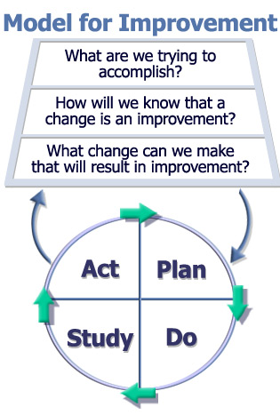
PDSA model
The Improvement Guide, API

Slide 76
PDSA model
1. Plan (results are dependent on the quality of the plan)
identifying what will be done, roles and responsibilities, and timescales
objectives, predictions, risk, evaluation planning
2. Do (plan is put into action)
  data for monitoring and measuring the changes will be collected and observations recorded.
3. Study (review and reflection)
  data will be analysed and compared with predictions
  ideas for improvements to the cycle should be raised
4. Act. (decide on next cycle)
  may be that the cycle should be run again with improvements made, or further cycles should be created to develop the changes
The cycles should be small and simple. In this way, getting started is easy, and you can move quickly through each stage and apply the learning quickly. It also reduces risk, as anything that goes wrong will not have a large impact. Running a few successive cycles will build on learning and allow effective, easily accomplishable and proven changes to the system.

Slide 77
Step 1 – Identify the problem
How do you know there is a problem?
What is the impact of the problem?
Is the problem stated objectively?
What is the scope of the problem?
Is there an implied solution in your problem or goal statement that you need to remove?

Slide 78
Step 2 – Define the problem
Involve stakeholders
Gather and analyse information
Talk with people who are familiar with the problem
Clarify what it is / is not - problem definition tool

Slide 79
Step 3 – Diagnose cause(s)
Root Cause Analysis techniques
5 Whys
Cause & Effect (Ishikawa / Fishbone) diagram

Slide 80
Step 3 – Diagnose cause(s)
Example of 5 Whys:
Patient was late in theatre, causing a delay. Why?
There was a long wait for a trolley. Why?
A replacement trolley had to be found. Why?
The original trolley's safety rail was worn and had eventually broken. Why?
It had not been regularly checked for wear. Why?
There is no equipment maintenance schedule.

Slide 81
Step 3 – Diagnose cause(s)
Environment
Procedures
Not computerised
Transport arrives early
Not enough treatment rooms
Too much paperwork
Poor scheduling
Clinics running late – lengthy waits for patients
Lengthy booking process
Small inner-city environment
Not computerised
Poor maintenance
Unexpected patients
Broken lifts
Staff unavailable
Not enough wheelchairs
Queue jumping
Long term sickness absence
Equipment
People

Slide 82
Step 4 – Generate options
Brainstorming
Slip method
Nominal group technique (Delbecq and VandeVen)
Idea-writing (Moore & Coke)
Cluster similar or related ideas under headings or themes
Condense ideas
Refine ideas - how ideas might be improved
Reduce your list of possible solutions to a manageable number of realistic/attractive options

Slide 83
Step 6 – Implement decision
Key elements:
Action planning
Contingency planning (Risk Management)
Communication strategy
Monitoring, review and evaluation

Slide 84
Action Planning
Step 6 – Implement decision
SMART actions
Break tasks down
Allocate responsibilities
Agree timescales
Prioritise
Identify resource implications
Set review dates
Plan communication
Give adequate warning
Realistic timescales
Maintain effective teams
Enlist help of enthusiasts
Staff development?
Notes:
.

Slide 85
Contingency Planning
Step 6 – Implement decision
Risk | L (0 – 10) | I (0 – 10) | Mitigation
Key person goes off sick / leaves | 2 | 8 | Key person keeps detailed progress notes; has regular update meetings with identified colleague
L = Likelihood I = Impact

Slide 86
Step 6 – Implement decision
Evaluate the progress
 | Action Plan |  | ‘Desired goal’
What | SMART actions |  | Milestones, targets
Who | Person(s) responsible | Forum(s)?
When | Target dates | Regular progress reviews?
Where | Team meetings? Forum(s)?
How | Success measures

Slide 87
Activities
(Workbook)
Notes:
Refer to workbook

Slide 88
Close

