Slide 1
Data and Innovation
Co-chairs
Greg Jones
Chris Sainsbury

Slide 2
What we have done?
Formed (new group)
Met and agreed
remit,
membership
terms of reference

Slide 3
Remit
Access and use data to improve patient care
Support locally instigated innovative practice projects and disseminate learning from these projects
Guidelines

Slide 4
Change
“If you want to get people to do something, make it easy. Remove the obstacles.”
Prof. Richard Thaler

Slide 5
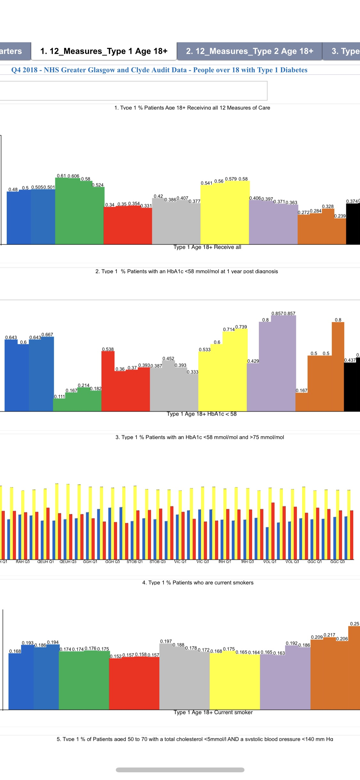
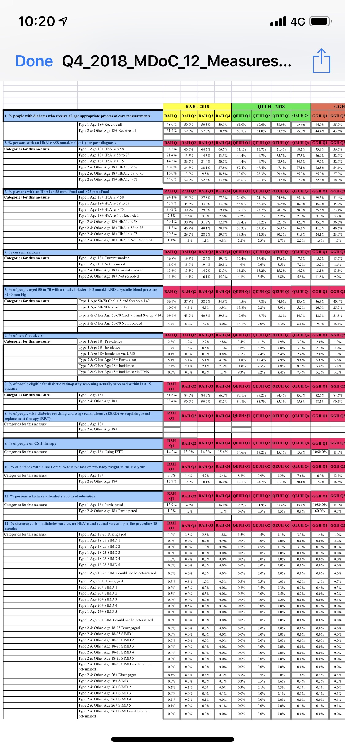

Slide 6
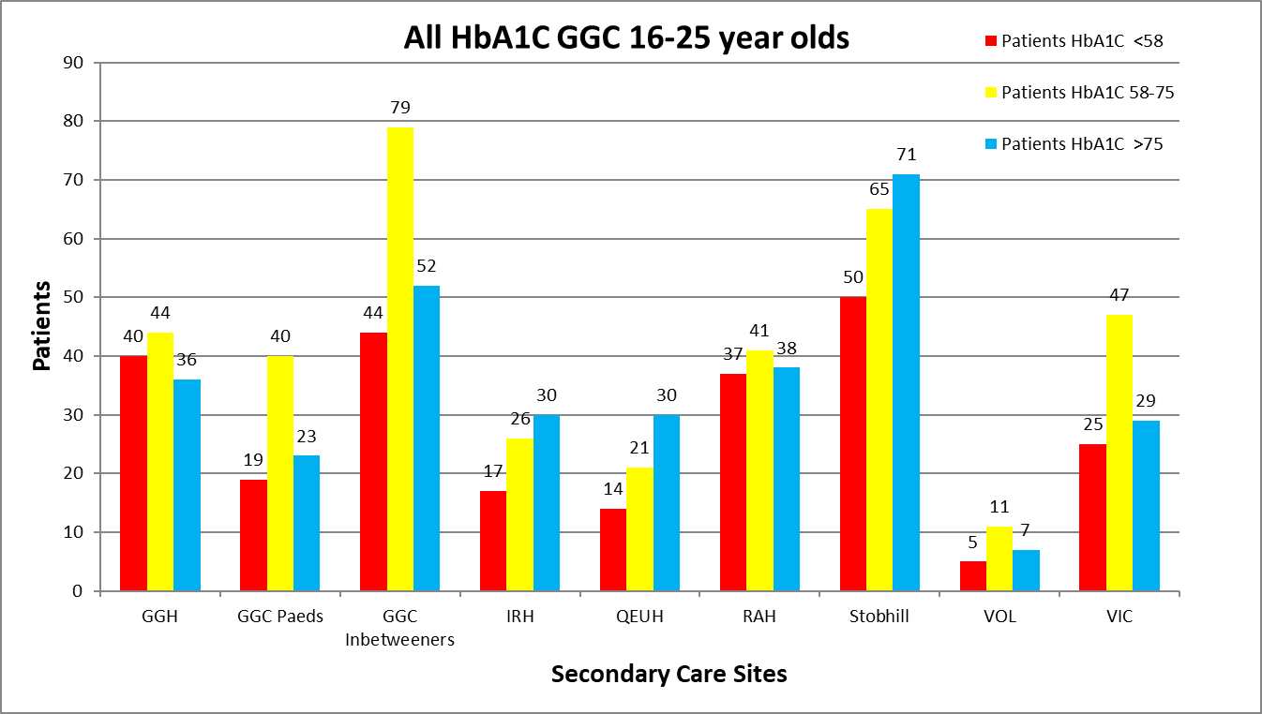

Slide 7
performance against target
Change
process
repeat

