Slide 1
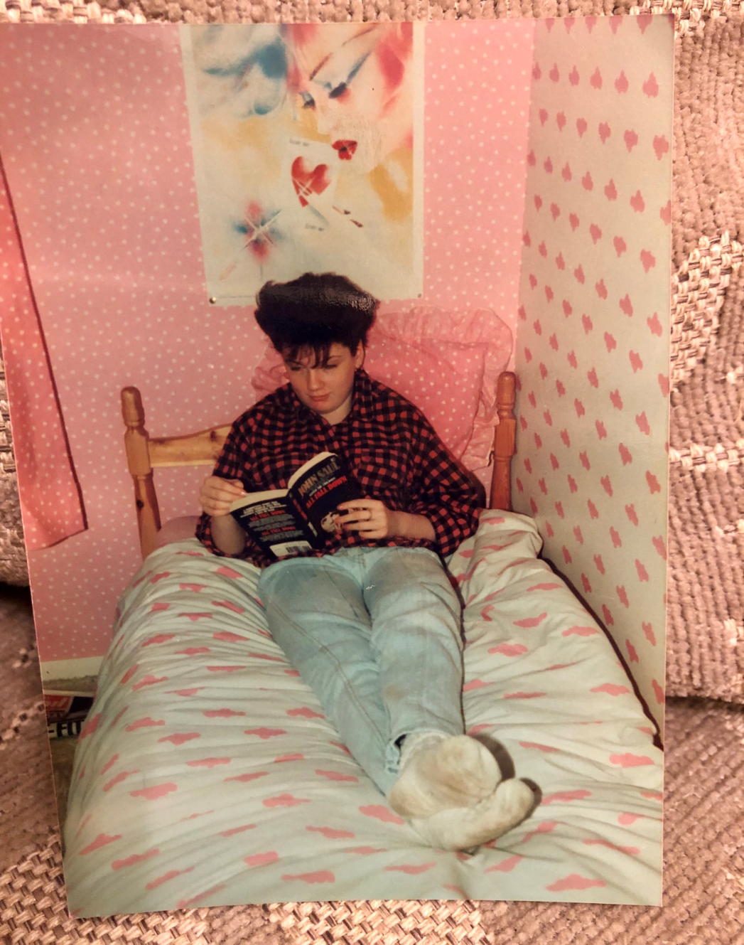
Typical teenager 1985
Louise Johnston
Diagnosed at Ruchill Hospital 18th December 1985.
My journey with Type 1 diabetes.

Slide 3
7:00 -Wake up, check blood, Take insulin, eat, get ready for work.
8:45 – Check blood before class, bolus if needed.
10:45- Check blood, break, coffee !
12:15- Check blood, work out bolus for lunch, take insulin.
2:00 – Check blood, fingers crossed.
6:00 – Check blood, work out bolus for dinner, take insulin, eat.
Repeat Repeat Repeat

Slide 5
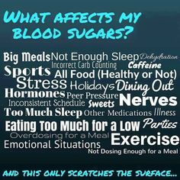
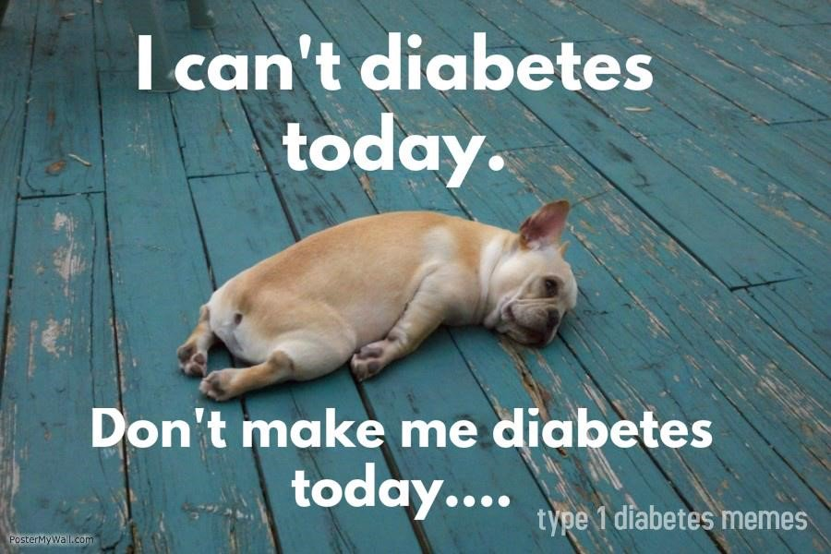
Low blood sugar/ High blood sugar hardest to deal with.
Sometimes can happen for no obvious reason at all.
Diabetes Burnout.

Slide 6
1989: began Primary Teaching degree.
First in family to go to university.

Slide 7
Stobhill Hospital

Slide 8
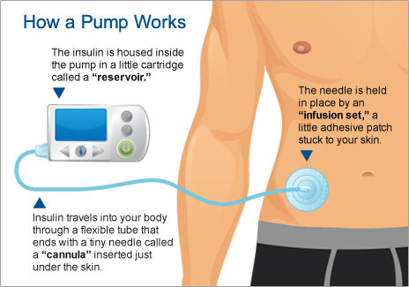
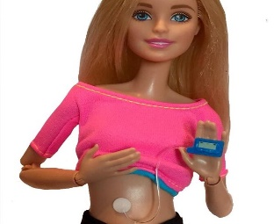
February 2016: began using Insulin Pump.
Ability to fine-tune my doses = a big difference!
Connected but still felt like freedom.

Slide 9
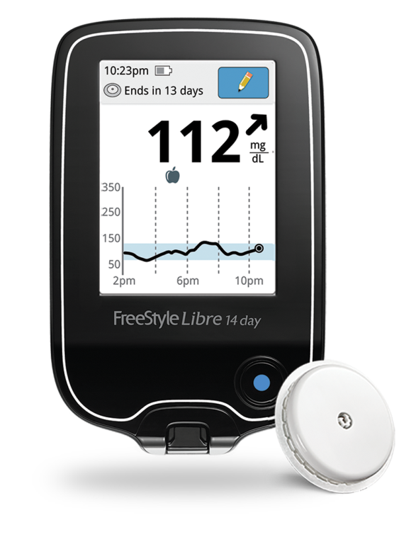
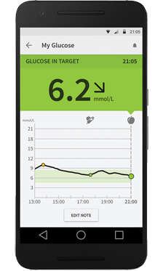
DAILY PATTERNS
LOW GLUCOSE EVENTS
TIME IN TARGET
SENSOR GLUCOSE READINGS

Slide 10
“Love the Libre. No bother to check blood, just scan. Libre Link-up App lets me see live scans when daughter is at school. She doesn’t feel it is a burden anymore !”
“The libre helps me manage my sugars in the night. I used to get a lot of night- time hypos, I can see exactly what is happening and make adjustments, now hypo free.”
“The Libre has given me my confidence back. I feel that now I can do this !”
“I love the graphs, they inspire me to get better and better blood sugars.”
“Libre has helped me to stop my retinopathy getting worse.”
“I have kidney problems. Using the libre has helped me get my hba1c down and I feel much better.”

