Slide 1
Undertaking Ready to Lead
The Leadership Challenges for NHSGGC
Tuesday 1st November 2016
WELCOME
Please fill out your name place holder – both sides –
whilst you are waiting

Slide 2
Today’s Session:
09.15 Welcome, Objectives for today Doug
        09.30 Workstream Introductions All
09.40 Introduction to Delivered Modules and Improvement Project
        Leading Continuous Improvement Colin Aitkenhead
        Clearwater Brookes
        Leading Effective Teams Agnes Hendry
        Aston OD
        Emotional Intelligence Sue Simpson
        Sue Simpson Assoc.
        Taking Forward your Improvement Project Doug Mann
        Improvement Project
        My Experience of Ready To Lead Louise Gunson
        10.30 The Leadership Challenge for NHSGG&C Catriona Renfrew
        Director Planning and Policy
        11.00 Coffee and Networking
        11.10 Introduction to Delivered Modules continued
12.15 Open Discussion/Remaining Questions All
12.30 Lunch and Networking All

Slide 3
Our Objectives for Today:
To allow delegates get to know their aligned workstream
colleagues in advance of first delivered module
To offer individuals an opportunity to network with the wider
cohort of participants
To provide an opportunity to hear a senior management perspective
  on the leadership skills needed to face the challenges of the future
To provide a preview of delivered modules and to meet their
providers
To offer some additional information to delegates to support
undertaking their Improvement Project
To make delegates aware of the additional materials and support
available to them

Slide 4

Workstream Introductions

Slide 5
What you need to do – take a few seconds to…..
Make sure your name place holder is filled in – both sides
Take a second to introduce yourself to Workstream colleagues at your
tables (if you haven’t already)
Initially work with the person next to you and share the most important learning
you hope to achieve from undertaking Ready to Lead
Highlight one important question you need clarified today (if you have this)
Move around your table sharing objectives and questions, changing partner
until you have spoken to all workstream colleagues
Capture your question for raising later if needed
You have 10 minutes

Slide 6

    Introduction to the Delivered Modules and additional
    Support:
  Workstream 1 - Leading Continuous Improvement
  Workstream 2 - Leading Effective Teams
  Workstream 3 - Emotional Intelligence
  Workstream 4 - Taking forward your Improvement Project
  Workstream 5 – My Experience of Ready to Lead

Slide 7


The Leadership Challenge in NHSGGC
Catriona Renfrew
Director Planning and Policy

Slide 8
What are the challenges: environmental?
Political environment
Financial pressures
External targets
Quality rhetoric and reality
Continual clinical and service change
Complexity and pressure
System conflicts
Workforce cohesion
Social context
Organisational change

Slide 9
What are the challenges: personal?
Behaviours
Positive not negative responses and attitudes
Nurture and value people and relationships
Careful conversations
Constructive challenge
Relate work and focus to patients
Create mutuality and teams
Recognise creative and destructive conflict
Take personal responsibility
Influence beyond own area system leadership

Slide 10
Where do we need to be: Facing the Future Together?
All our managers should also be effective leaders. Leadership is management plus. It is more than managing transactions, it is managing with vision and with imagination, with a drive for positive change and with a real focus on engaging staff and patients.
Our Managers need to:
  be better equipped and supported to perform effectively
  work with clearer and more consistent organisational requirements and real incentives for delivery, particularly on relationships with staff and quality of services
  be able to develop beyond management into leadership
  be highly motivated and respected by the staff they work with

Slide 11
Where do we need to be: Facing the Future Together?
NHS GGC
Leadership
Standards, Values
& Competencies
We take accountability
We work as one team
Impartiality
Strategic
Focus
Collaborative
Partnership
Approach
Resilience
Political
Awareness
Accountability
For Results
Achieving Value for Money & Financial Efficiencies | Working with Partners
Focus on Service Quality & Improvement | Engaging Staff
Flexibility
Influencing &
Negotiating
We focus on outcomes
Initiative &
Creativity
We treat each other
with respect
We put patients first
Champions
Change
Professional
Growth
We always try to do things better

Slide 12
Lots of really good quotes about leadership………….
Management is doing things right; leadership is doing the right things
The values you walk past are the values you set
The way you see them, the people you work with, is the way you treat them and the way you treat them is the way they often become
Good management is the art of making problems so interesting and their solutions so constructive that everyone wants to get to work and deal with them

Slide 13
In practise………..
Be visible, engage and do it early
Listen and communicate effectively
Be proactive and action focussed
Engage with the challenges, don’t avoid
Build, invest in development and work with your team
Understand wider organisational issues, dynamics and processes
Be resilient, persevere, see things through….don’t let things go
Seek advice, wisdom and guidance from others
Be optimistic, positive and enthusiastic
Act with integrity and probity
Give and accept feedback
REFLECT REFLECT REFLECT…………
USE this programme to think and to develop your skills
USE FTFT in your work going forward

Slide 14

Coffee and Networking
Again… introduce yourself to as many people
you don’t currently know as you can

Slide 15
    Introduction to the Delivered Modules Continued
  Workstream 1 - Leading Continuous Improvement
  Workstream 2 - Leading Effective Teams
  Workstream 3 - Emotional Intelligence
  Workstream 4 - Taking forward your Improvement Project
  Workstream 5 – My Experience of Ready to Lead

Slide 16

Additional Information and Ongoing Support

Slide 17
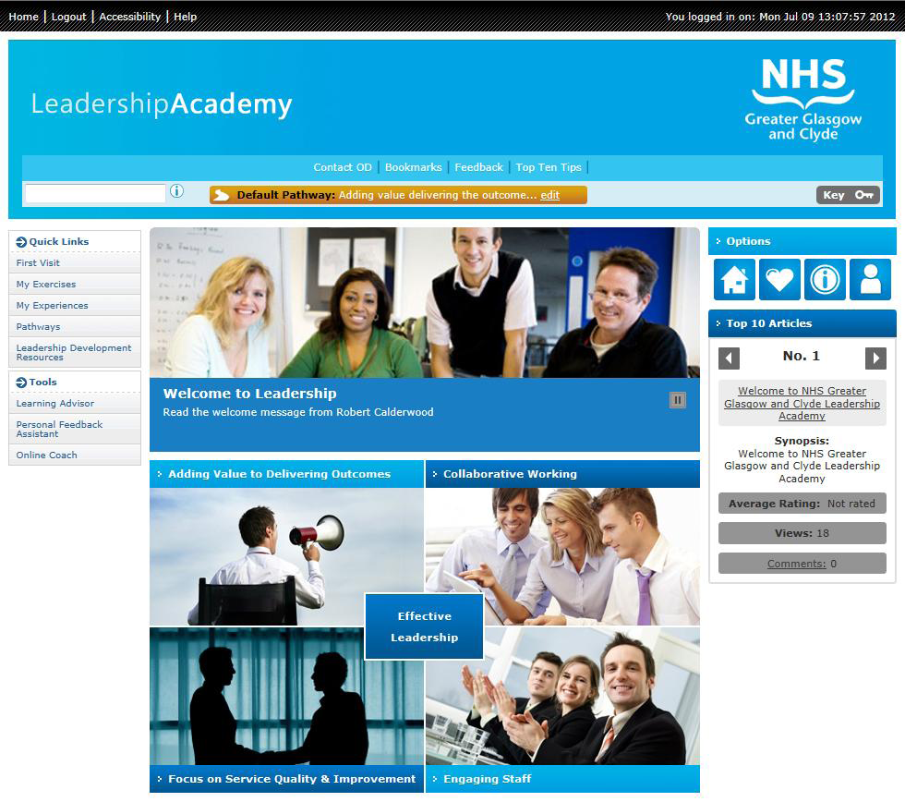
http://www.staffnet.ggc.scot.nhs.uk/Human%20Resources/Organisational%20Development/Pages/LeadershipAcademy.aspx

Slide 18
Tools and techniques to support developing your leadership skills and knowledge.
Podcasts
Strategic Influencing http://www.staffnet.ggc.scot.nhs.uk/Human%20Resources/Organisational%20Development/Pages/StrategicInfluencing.aspx
Leading Through Change http://www.staffnet.ggc.scot.nhs.uk/Human%20Resources/Organisational%20Development/Pages/LeadingThroughChange.aspx
Supporting process improvement http://www.staffnet.ggc.scot.nhs.uk/Human%20Resources/Organisational%20Development/Pages/ChangeandImprovement.aspx
A Wellbeing and Resilience Toolkit
– designed to support individuals and managers http://www.staffnet.ggc.scot.nhs.uk/Human%20Resources/Organisational%20Development/Pages/ResilienceToolkit.aspx

Slide 19


The Leadership Alumni
Created to:
Support members maintain focus on their continued development
Establish a learning network
Encourage members provide and support learning events
Encourage members come together to tackle common but “wicked”
problems and learn from each other’s experience
Encourage “return on development investment”
Input to organisational activities or queries
Aimed at:
Graduates of full leadership programmes eg Ready to Lead
Supported by an annual programme of masterclasses and
network events
Supported by professional media capability ie Linkedin
Leadership
Alumni
http://www.staffnet.ggc.scot.nhs.uk/Human%20Resources/Organisational%20Development/Pages/LeadershipAlumnihomepage.aspx

Slide 20
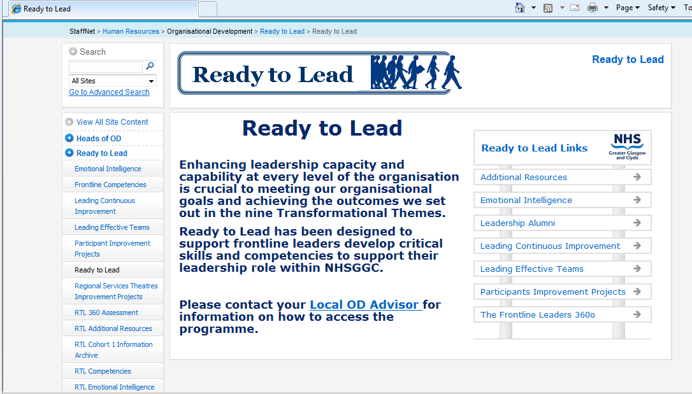
Online Information and Material – via dedicated Ready to Lead pages on Staffnet
http://www.staffnet.ggc.scot.nhs.uk/Human%20Resources/Organisational%20Development/Ready%20to%20Lead/Pages/ReadyToLead.aspx

Slide 21
How you can support us:
Return your Commitment Form – work with your manager to complete this
Return your Improvement Project Form – ensure you have full
sponsorship and your managers support
Make sure you plan to attend all modules if you have any
problems let Lisa know as early as you can – make sure these are in
your diary
Make good use of the additional sessions we offer
Take time to complete evaluations and attend our final session
– we use your feedback to improve the programme for future delegates
Share your improvement project with us and future delegates
Consider sharing your experience and knowledge by becoming a
Mentor or joining our Alumni
Consider sharing your experiences of the programme with the next
intake of Ready to Lead delegates circa April 2017

Slide 22

Open Discussion and Questions
You may wish to use the questions you
captured this morning

Slide 23

Light Lunch and Networking

